Slide 1

BANKRUPTCY PREVENTION
PROJECT – 334
GROUP - 4

Slide 2

GROUP MEMBERS
ABIJITH SURESH
SREEDEEP EK
THEJAS S
RUTIKESH HATIM
VAISHNAVI PAWAR
SHRIKANT KATEKAR
AJINKYA GALANDE

Slide 3

CONTENTS
Abstract
Introduction
EDA
Data Visualization
Model Building
Model Evaluation
Model Deployment
Result

Slide 4
ABSTRACT
The Classification algorithm is a Supervised Learning technique, that is used to identify the category of new observations on the basis of training data. In classification, a program uses the dataset or observations provided to learn how to categorize new observations into various classes or groups.
Classification predictive modelling is trained using data or observations, and new observations are categorized into classes or groups.
This algorithm is simple to implement, robust to noisy training data, and effective if training data is large
Classification algorithms are used to analyse discrete values, The output variable must be either continuous nature or real value.

Slide 5




INTRODUCTION
Objective :
This is a classification project, since the variable to predict is binary (bankruptcy or non-bankruptcy). The goal here is to model the probability that a business goes bankrupt from different features.
The data file contains 7 features about 250 companies
Project Architecture :
Data Collection – Data Cleaning/ EDA – Data Visualization – Model Building – Model Evaluation – Model Deployment – Result.
Challenges Faced :
As the data set contains only 3 unique values and half of the values are identified as duplicated values and more the size of the data is small with 250 entries which results in inaccurate reporting, data integrity problem.
The biggest challenge is identifying the result in business point of view and making a decision on selecting the best model for deployment part.

Slide 6
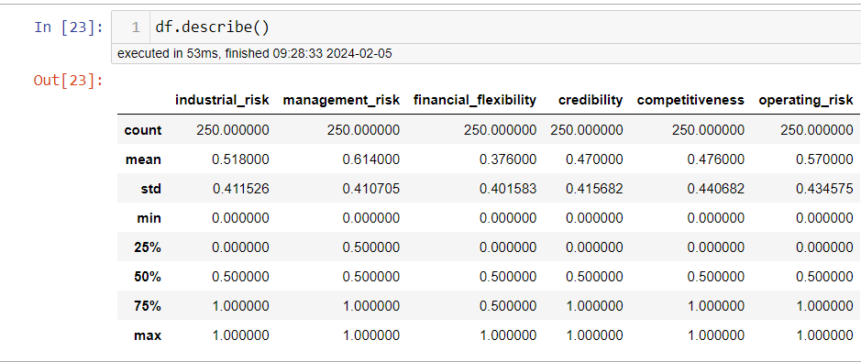
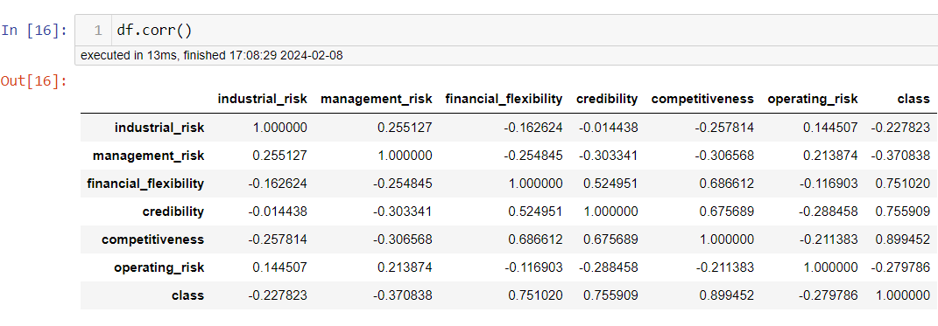
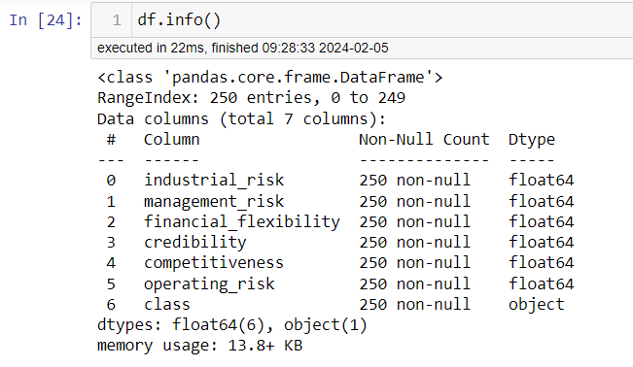
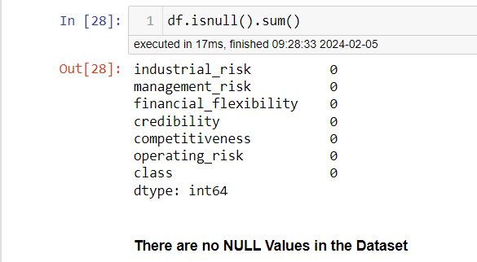
E
D
A

Slide 7

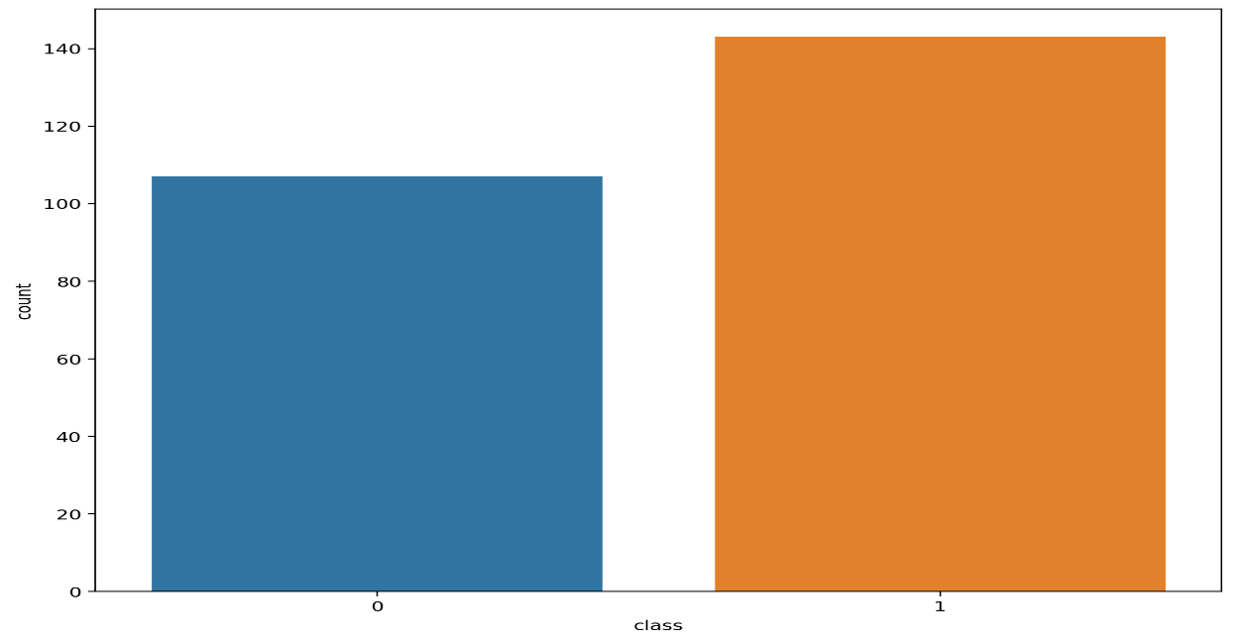
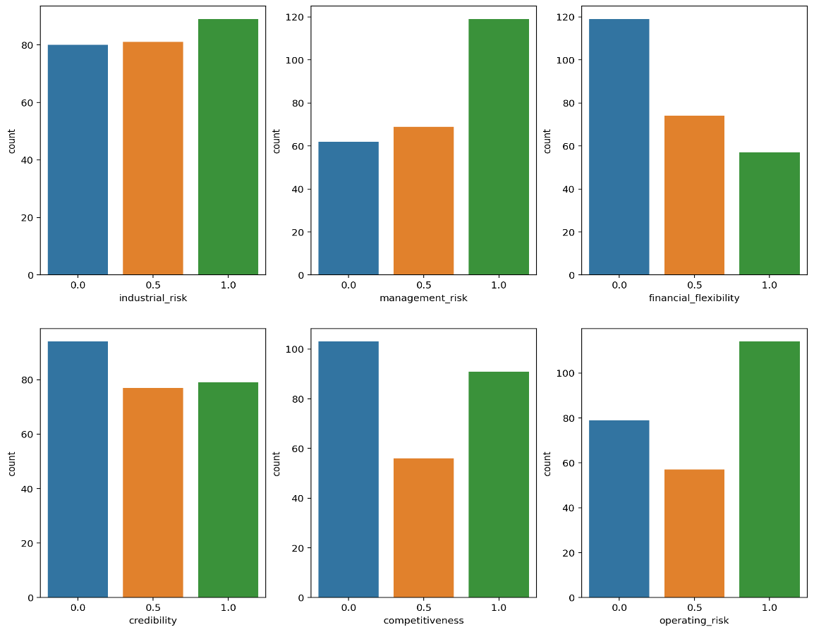
DATA VISUALIZATION
The illustration describes the value counts of the target variable “ CLASS “ and it shows most of the Companies are Non-bankrupt.
This plot shows value counts of the companies with respect to the all independent variables

Slide 8

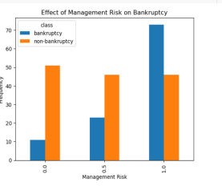
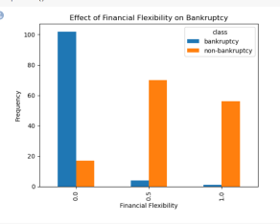
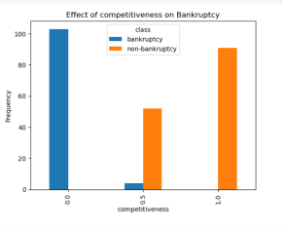
.
The plot shows the effect of management risk
on bankruptcy and
it illustrates risk of bankruptcy is more when the given information is classed as 1 comparing to rest division.
The plot shows under financial flexibility the bank doesn’t go any bankruptcy and it illustrates risk of bankruptcy is less according to the given information
The plot shows under competitiveness the bank doesn’t go any bankruptcy and
it illustrates risk of bankruptcy is less
according to the given information

Slide 9

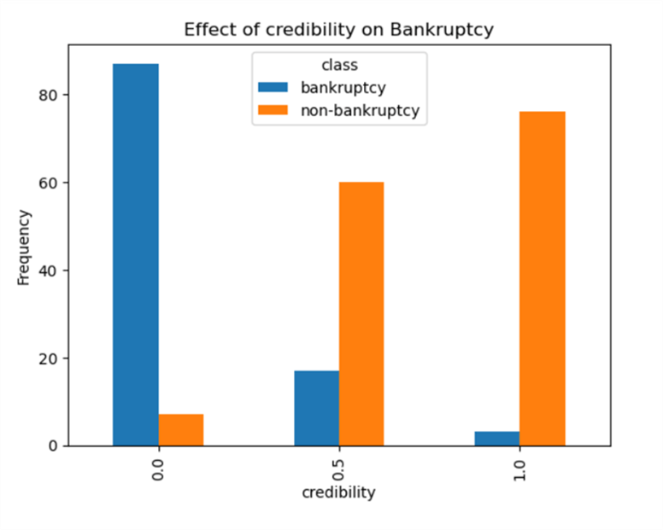
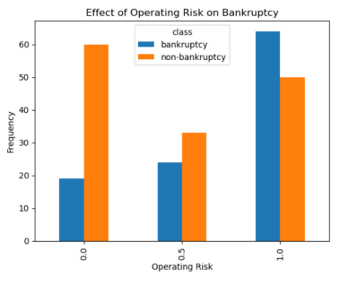
The plot shows under credibility the bank doesn’t go any bankruptcy and illustrates risk of bankruptcy is less according to the given information
The plot shows under operational risk the bank does go bankruptcy and illustrates risk of bankruptcy is more
according to the given information

Slide 10
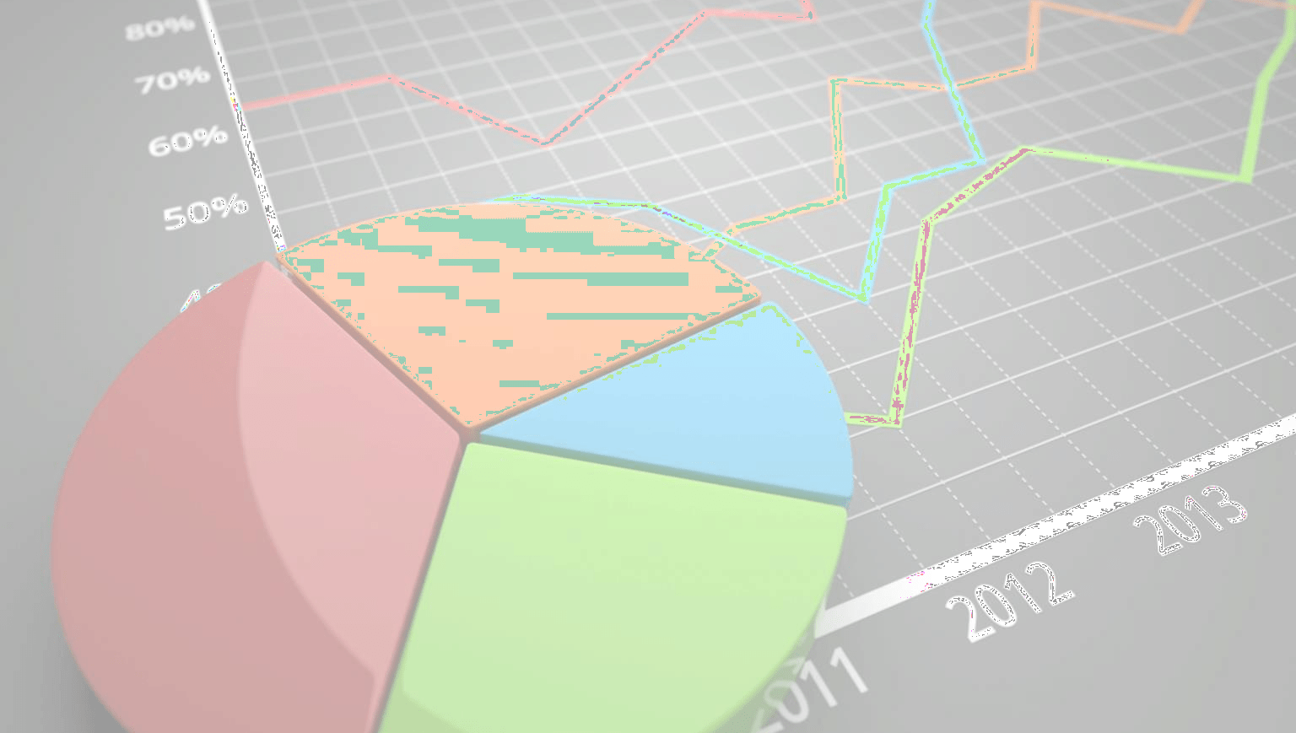
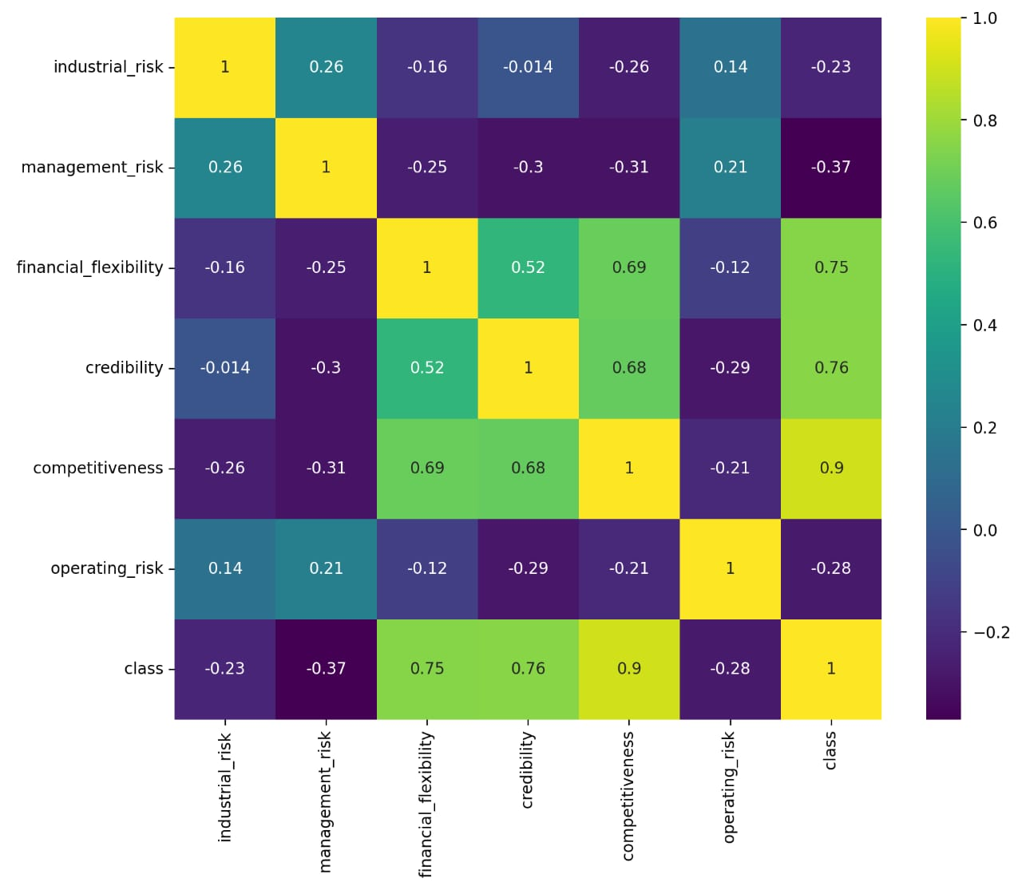
This Heatmap shows there are 3 independent variables that are highly correlated with the target variable. Following variables are highly correlated with target class : 1 . Financial_flexibility 2 . Credibility 3 . Competitiveness
.
•
.

Slide 11

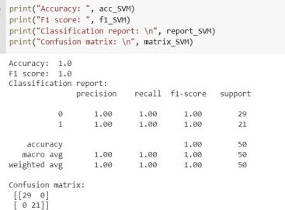
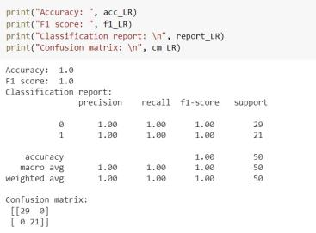
MODEL BUILDING
The train and test split was with the size of 0.8 and 0.2 with random state 42.
Furtherly six models are built under this train and test size along with fixed random state
Support vector machine
Logistic regression

Slide 12
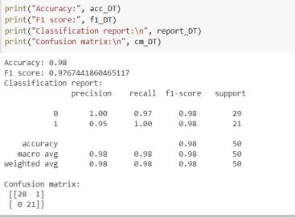
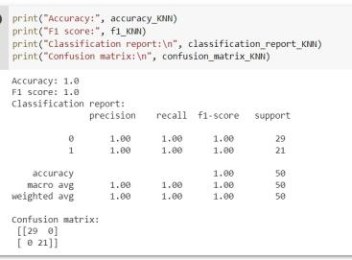
Decision tree
KNN

Slide 13
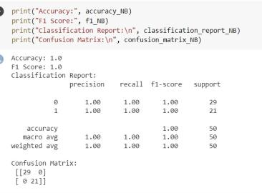
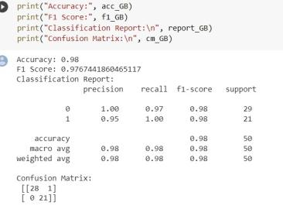
.
Naive bayes
Gradient Boosting

Slide 14
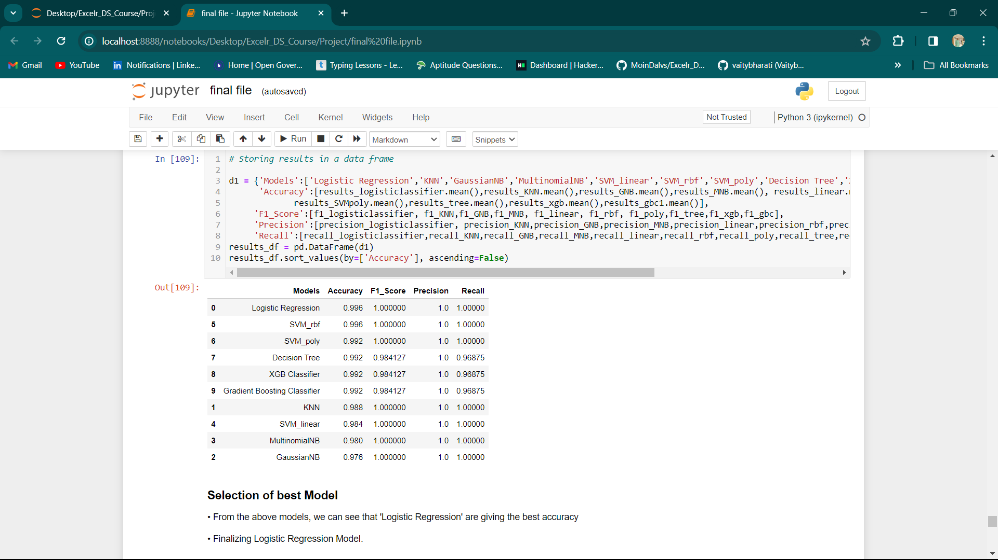
MODEL EVALUATION

Slide 15
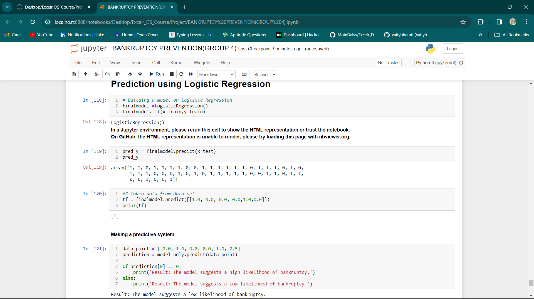
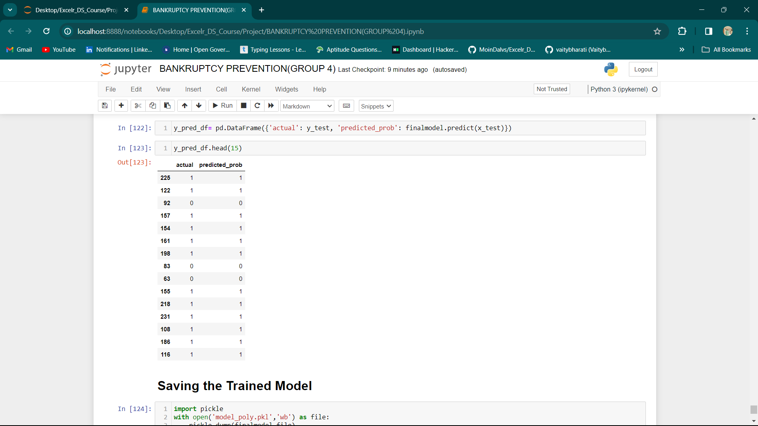

Slide 16
MODEL DEPLOYMENT
Streamlit is an open-source app framework in python language. It helps us create beautiful web apps for data science and machine learning in a little time.
It is compatible with major python libraries such as scikit-learn, keras, PyTorch, latex, numpy, pandas, matplotlib, etc.

Slide 17
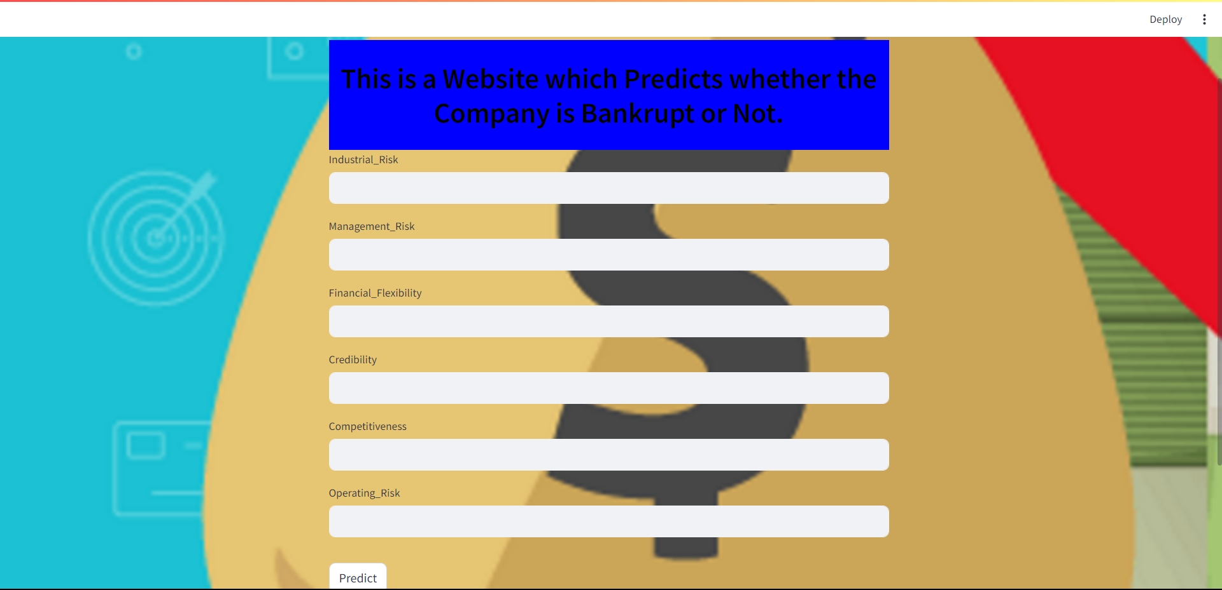
.

Slide 18


